Slide 1

Business start-up project

Slide 2
Writing a product launch file
1. Present the company's business plan
2 Complete the Financial documents
3. Draw up the commercial and technical file
Groups of 2 students
Convincing investors to finance your project or your managers
- You have €10,000 in personal funds
The remainder of the funds will come from a bank loan of up to €1,000,000.

Slide 3
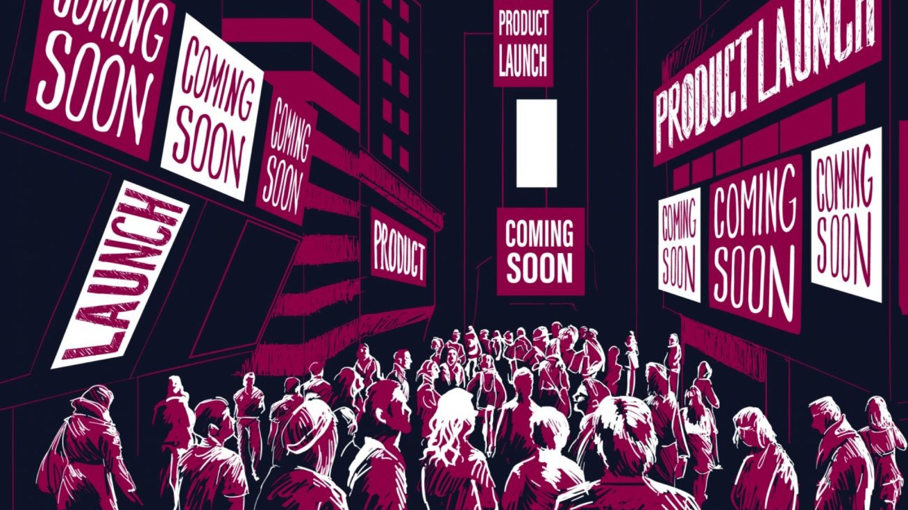
Assessment criteria
Project realism :
a company you know, or set up a company with a product or service that interests you
The level of detail in the file is as close to reality as possible
Demonstrate the financial viability of the project to convince investors
.

Slide 4

Choice of product
Advice on choice
- Quantifiable costs
-Realism and accuracy of calculations must take precedence over the originality of the project
-Choose a product that is relatively basic but has an element of differentiation (design, new functionality, etc.).

Slide 5

Le business model
- What value for your customers?
- How does it organise itself to meet a customer need and make money?
- Find a coherent value proposition and strategy around it
IKEA quality designer furniture at low prices, easy to transport

Slide 6
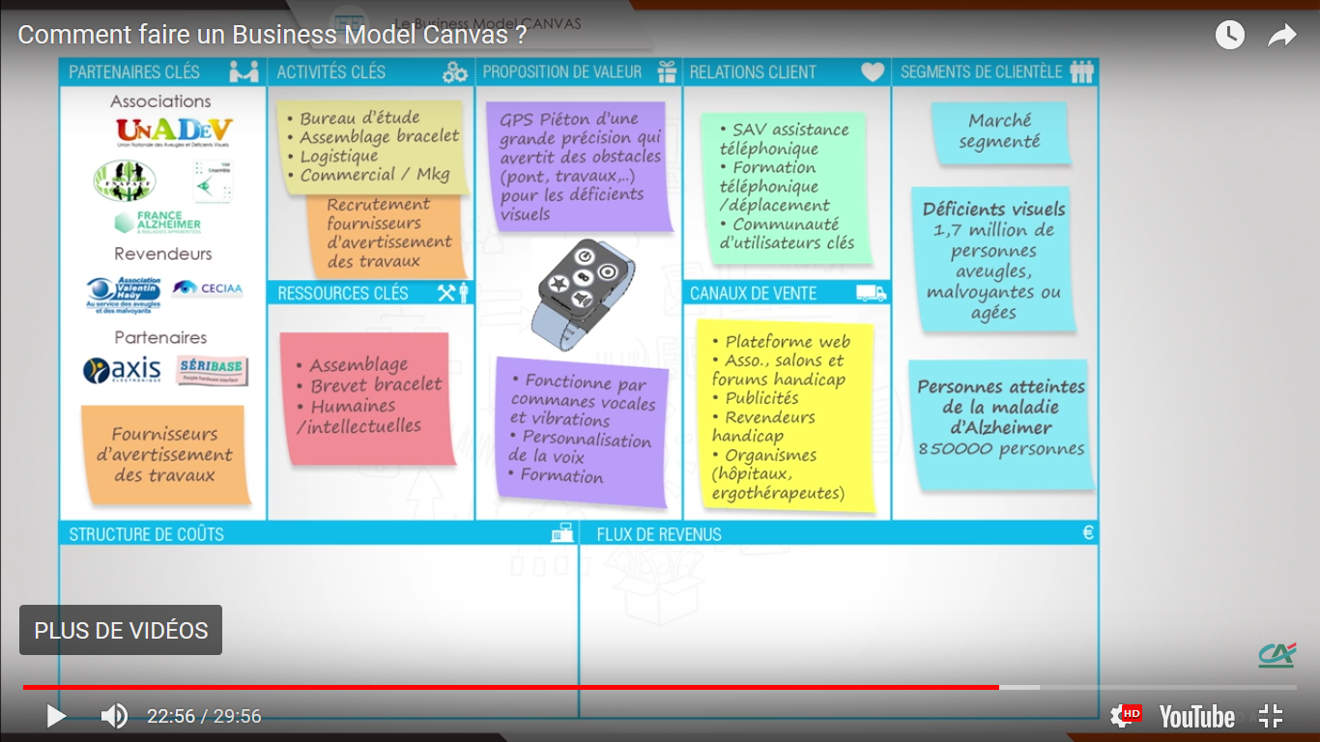
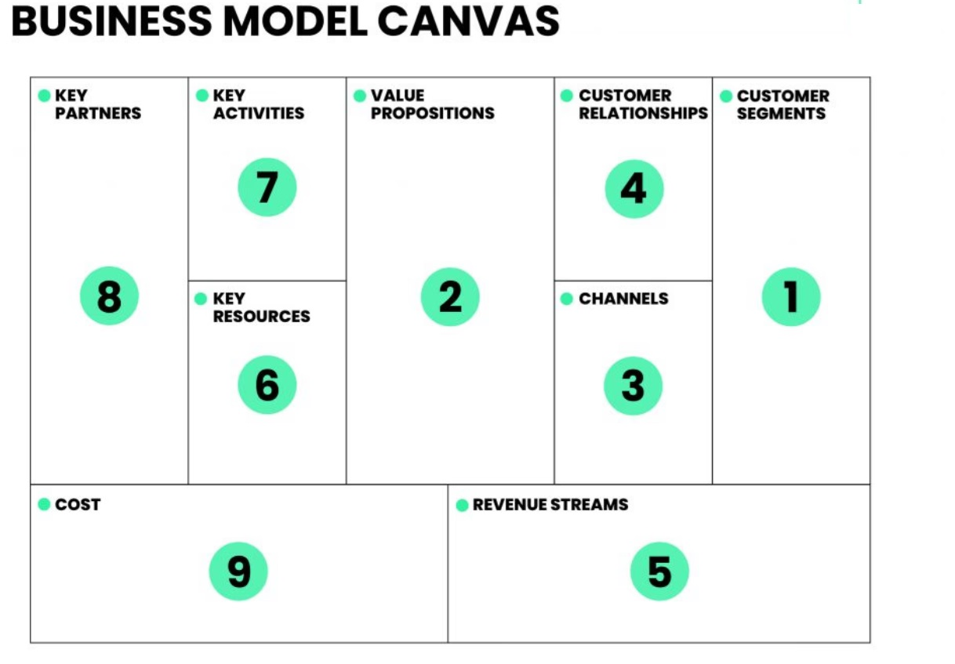

Slide 7

Project content
-Completing my Business Canvas
-Writing my business plan
-Drawing up my financial file
-Drawing up my data sheet
-Drawing up my SWOT

Slide 8

The business plan
Presents the key components of your business project
a management tool, but also a communication tool for partners and financial backers
Demonstrate the viability of your project
- Studying the market,
- Set up a commercial strategy,
- Drawing up financial forecasts
- Choosing a legal status

Slide 9

Market research
Find out more about the chances and conditions for the success of your project
What do you want to sell? To whom?
How are you going to sell it?
Who are your competitors?
Are there any specific regulations governing this market?
A prime location?

Slide 10

Legal status
significant impact on both your business and your personal and family life
Things to consider before choosing it :
- your company's activities,
- your financial and family concerns,
- but also the image you wish to project of your company...

Slide 11
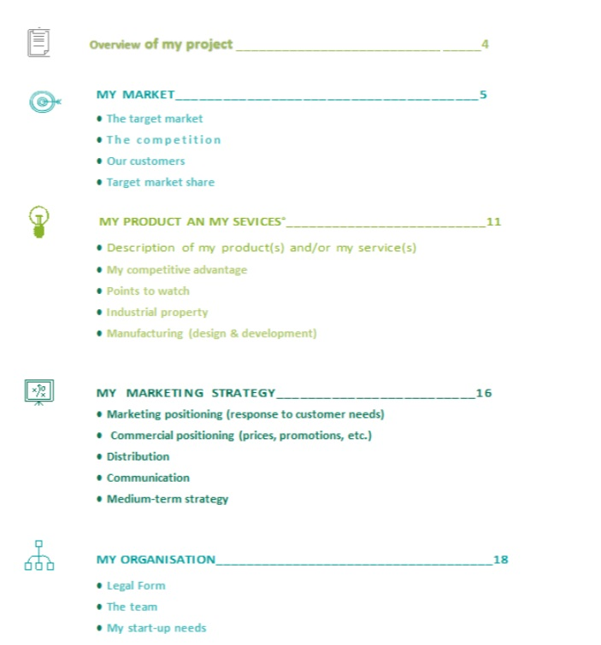
My Business Plan

Slide 12

The financial file
Complete the Excel file, explaining your figures in detail and demonstrating the financial viability of the project.
-Income statement
-Balance sheet
-Financing plan

Slide 13
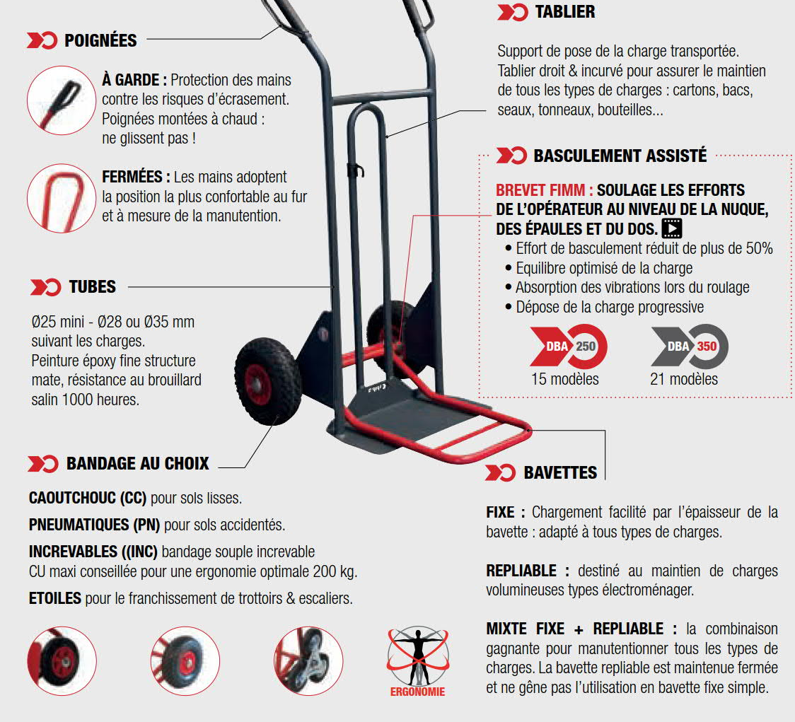
Produce a data sheet
Present the technical aspects of the product or service, draw up plans, present the functionalities...

Slide 14
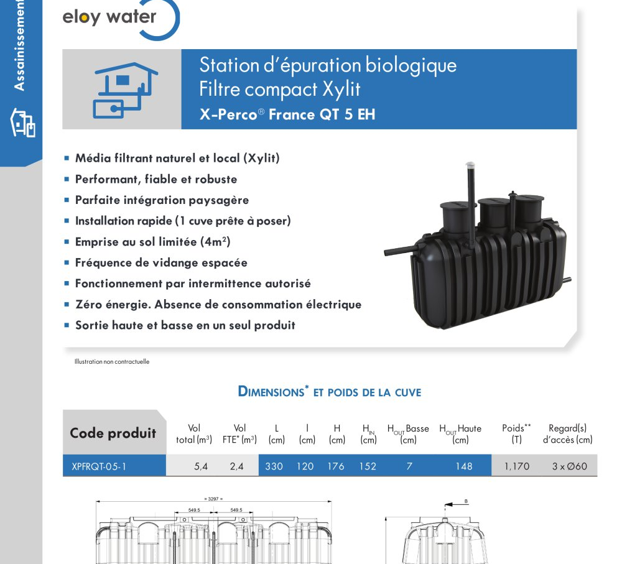
Example of a data sheet

Slide 15
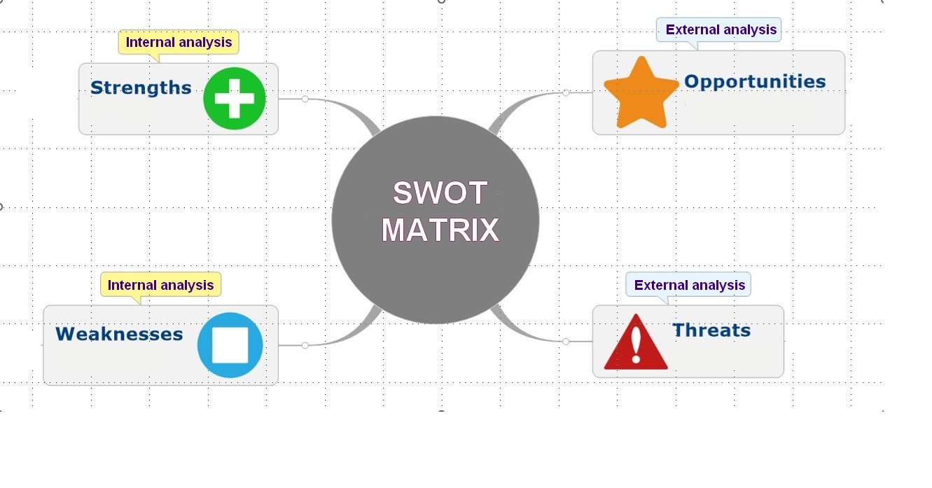

Slide 16
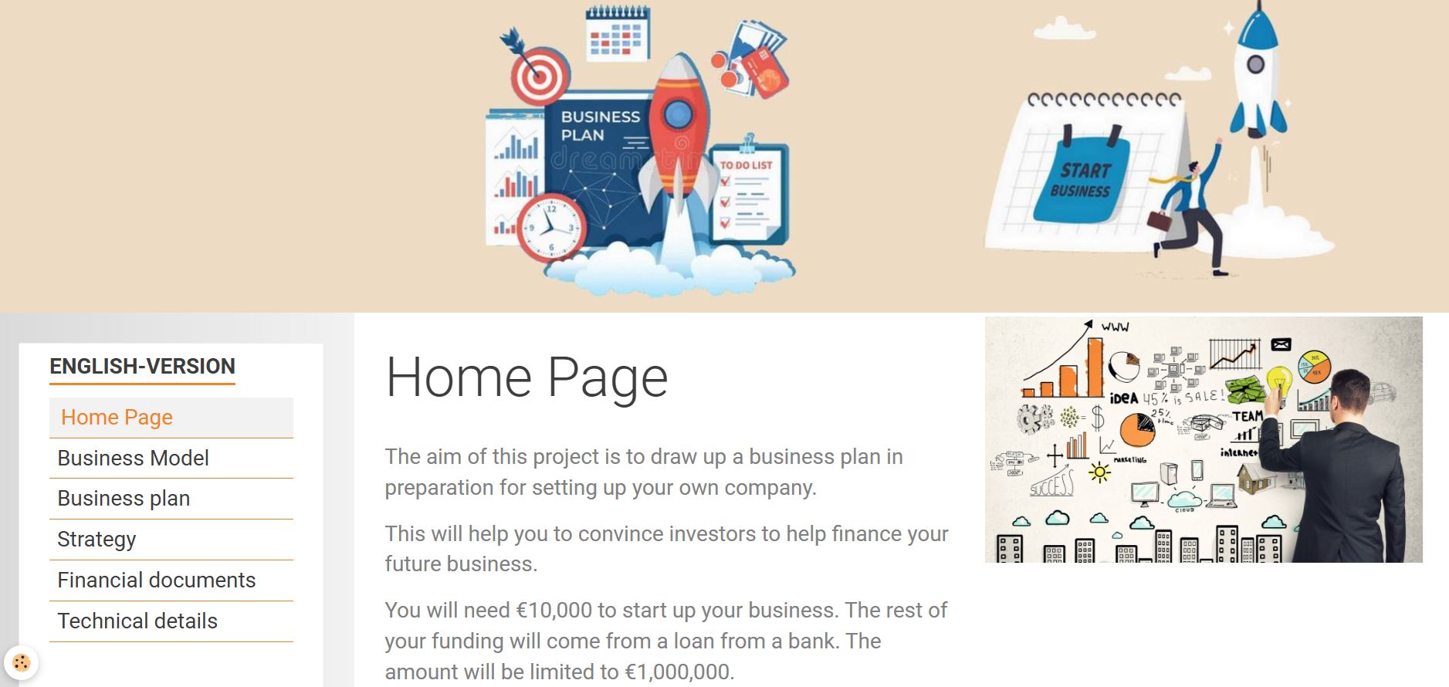
All the documents can be downloaded from:
:
projet2050.net

Slide 17

Come up with an idea to launch the product...
Groups of 2 or 3 students
And now to work

Slide 18

Contents of the file
- Business Canvas
- Business plan
- SWOT matrix
- Financial file for first year of business (income statement, balance sheet, etc.)

